Slide 1

ZOMATO RESTAURANT LAUNCH INSIGHTS
Presented by
Negasree Prasath

Slide 2

About Zomato
It is an Indian multinational food delivery company and restaurant aggregator was founded in 2008 by Deepinder Goyal and Pankaj Chaddah.
Zomato offers information, menus, and reviews of restaurants, as well as food delivery options from partner restaurants.
Zomato also provides an online restaurant discovery guide with information on dining out, home delivery, nightlife, and cafes.

Slide 3
Problem Statement
Zomato team is looking for business expansion and want to open new restaurants.
Key focus areas:
Analyzing total restaurants that are currently in business. Country-wise restaurant distribution.
Ratings and votes distribution to get an understanding of customer feedback and preferences
Availability of effective and quick help through online delivery and table booking options.

Slide 4
Key metrics:
Restaurant ID: Unique identifier for each restaurant.
Restaurant Name: The name of the restaurant.
Cuisines: The type of cuisine offered by the restaurant.
Has_Table_booking: Indicates whether the restaurant has a table booking option (Yes/No).
Has_Online_delivery: Indicates whether the restaurant offers online delivery (Yes/No).
Price_range: A numeric value indicating the price range category of the restaurant.
Votes: The number of votes or ratings/(feedback) received by the restaurant.
Average_Cost_for_two: The average cost for two people dining at the restaurant.
Rating: The overall rating of the restaurant is based on user reviews.
Datekey_opening: The date when the restaurant was opened.

Slide 5
Analysis Approach
For data cleaning, used functions like COUNTBLANK() to check for missing values in all columns, removed the missing values from cuisines column.
VLOOKUP(), LEFT(), MID()+FIND() were used to insert relevant data such as Country names, Year, Currency formatting.
Pivot tables were inserted for quick summarization of required metrics and identify patterns in the data.
Data was filtered and sorted and corelated with different metrics like ratings, average cost for two, etc. to identify trends and behavior patterns of the data.
Charts and slicers were created and added to a dashboard to provide a concise representation of the data and help guide the discussion of new restaurants.

Slide 6
Overview
TOTAL RESTAURANTS
Total Number of Restaurants: 9542
Total Countries : 15
Global Average Ratings: 2.9
India has the highest number of restaurants with 8652 restaurants followed by United States of America with 425 restaurants.
9542
TOTAL COUNTRIES
15
AVERAGE RATINGS
2.9

Slide 7
Country: Total restaurants VS Ratings
The number of restaurants and their ratings were the key metrics used to determine the best locations for opening new restaurants.
Small number of restaurants would reduce competition and provide a good foundation for new restaurants.
Lower-average ratings would indicate the need for better services and quality.
Canada, Qatar, Singapore and Sri Lanka are suggested for new restaurant openings.

Slide 8
Table booking and Online Delivery
The percentage of restaurants offering online delivery and table booking options are very less.
45% of restaurants do not provide table booking and 46% do not provide online delivery.
As per our data, restaurants offering online delivery and table bookings are rated much higher.

Slide 9
Top Cuisines
Understanding which cuisines are popular helps in deciding what to offer in new restaurants to match customer preferences.
Globally, North Indian, Mughlai cuisine leads in popularity with the highest number of votes.
Chinese and fast food are also customer favorites.

Slide 10
Price Range Distribution
Price range will also help us understand spending behavior of the market.
Majority of the restaurants fall in the price range of 1-2, which suggests that the customers prefer affordable dining experience.
Offering restaurants that offer a price range between 1-2 will attract a large customer base.
A niche market for price ranges 3-4, which can be explored as the competition is less.

Slide 11
Yearly Restaurant Openings
Looking at the yearly number of restaurant openings helps identify trends and understand when and why growth happened. This would help in planning future expansions in the best conditions.
Analyze peak years to understand factors driving growth and replicate success strategies for future expansions.

Slide 12
Average cost for two (INR)
Checking the average cost for two will help determine the spending behavior of the countries
Among the suggested countries, (Canada, Qatar, Singapore and Sri Lanka) the average cost for dining varies significantly, reflecting different market dynamics.
Canada and Qatar offers a mid-range spending market,
Singapore is suited for high-end dining, and
Sri Lanka is budget conscious.

Slide 13



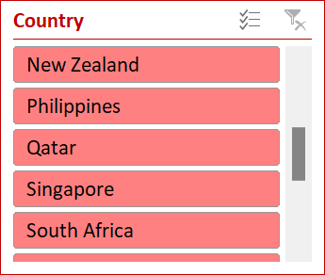
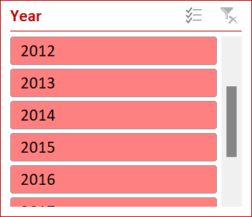
Dashboard
ZOMATO RESTAURANT LAUNCH INSIGHTS
TOTAL RESTAURANTS
TOTAL COUNTRIES
AVERAGE RATINGS
9542
15
2.9

Slide 14
Recommendation
It is suggested to open new restaurants in the below countries
1. Canada
2. Qatar
3. Singapore
4. Sri Lanka
As these countries has lesser number of restaurants and lower ratings, the competition will be lesser and focus on improving quality of food and service to improve customer satisfaction for higher ratings.
Consort and Yorkton in Canada has lesser ratings (<4.0) compared to other cities where opening a new restaurant is a good idea by improving quality of food and service to improve customer satisfaction for higher ratings.

Slide 15
Recommendation
Canada having only 4 restaurants with an average cost of 3081INR, indicates a good opportunity for growth because of low competition and an economical pricing.
In Canada, Chinese and Canadian cuisine are rated low. Focus in providing authentic Chinese cuisine with a unique dining experience will help capture the market.
The average rating is higher in the restaurants having online delivery and table booking so facilitating these two options is a greater option.
Opening restaurants in the price range of 1-2 would help us attract a large clients since we know that majority of the market is between these ranges.

Slide 16
Conclusion
Boost Ratings with Table Booking and Online Delivery
Restaurants with these services have higher ratings and improved customer satisfaction.
Recommended to include these services in all new restaurant openings.
Market Potential in Key Locations
Fewer restaurants mean less competition; lower ratings highlight opportunities to improve quality.
Canada, Qatar, Singapore, and Sri Lanka are ideal for new restaurant openings.
Spending Behavior
Understanding average cost for two helps tailor pricing strategies
Canada has a mid-range spending market with less competition, while Singapore offers a high-end market opportunity.
Price Range Offerings
Focus on price ranges 1-2 to attract a broader customer base.
Explore niche opportunities in price ranges 3-4 where competition is lower.

Slide 17

Thank you!

